Slide 1

The advantages and disadvantages of internet.
By Nagy krisztián dániel

Slide 2
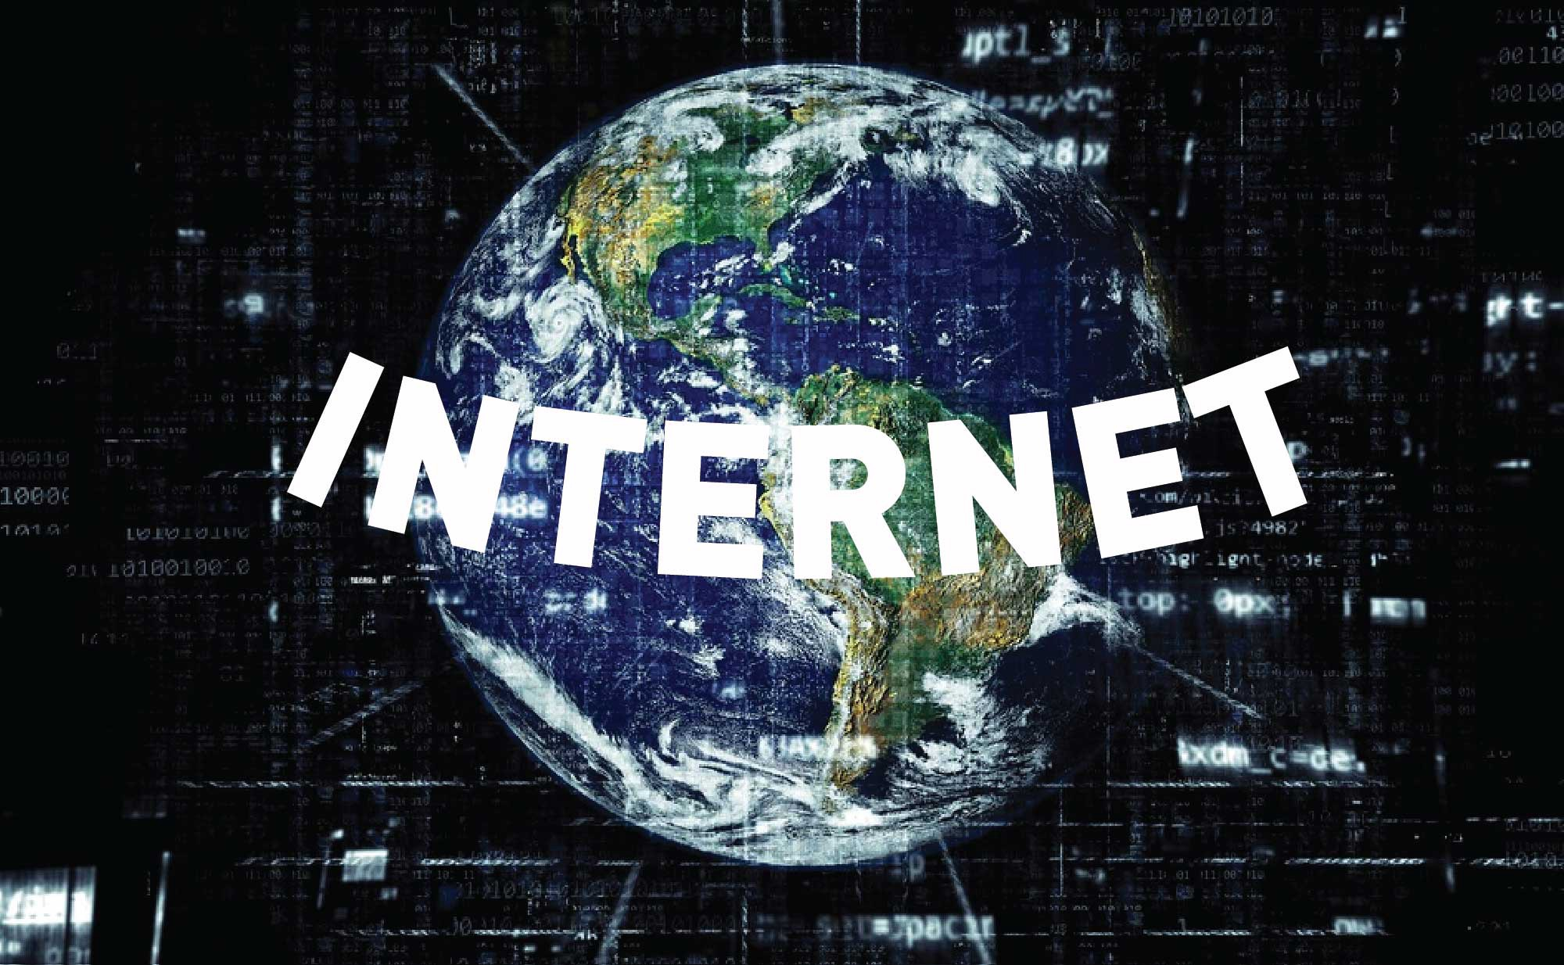
.

Slide 3




Introduction
Modern life has become easier and the people of the world have to thanks to the immense contribution of the internet technology to communication and information sharing.We can use internet to communicate with people around the world, doing business by using internet, make new friend and know different cultures, searching information, studying and etc.However, the internet also contains some unwanted elements or disadvantages. The following are the advantages and disadvantages of the internet.

Slide 4




The Advantages
Firstly, the internet can let a person to communicate with people in virtually any parts of the world through the internet or e-mail, without having to leave his room. Personal communication has also become more easier thanks to e-mail. Chat rooms, video conferencing are some of the latest additions in this technology and these have allowed peoples to chat in real time.With the help of such services, it has become very easy to establish a kind of global friendship where you can share your thoughts and explore other cultures.

Slide 5
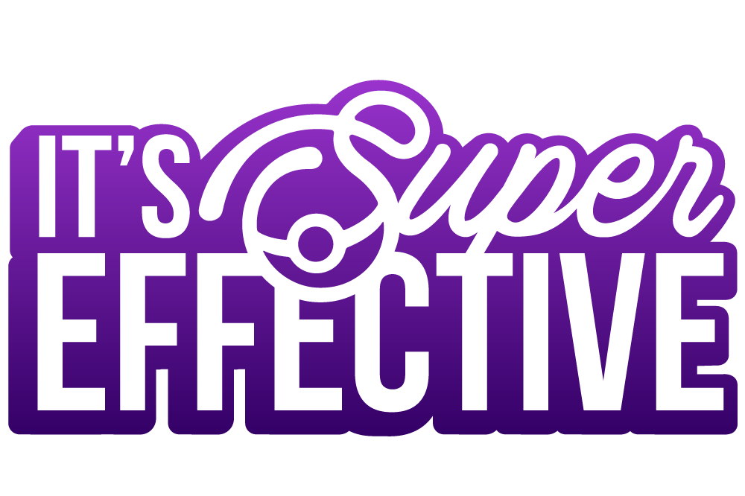
Second, information is probably the biggest advantages that internet offers. Internet is a virtual treasures trove of information.The search engines like Google, Yahoo are at your service through the internet. There is a huge amount of information available on the internet for just about every subjects known to man, ranging from government law and services, trade fairs and conferences, market information, new ideas and technical support, the lists is simply endless.
With this storehouse of information people can not only increases their knowledge bank but can do so without wasting their time through traditional means such as visiting libraries and conducting exhaustive research. With internet, students can save their times to search for information and using their time to do other works.University students and lecturers can communicate through internet. Besides, some universities are also offerings far distances courses to make study become more inefficient and convenience. Internet become a gateway for those who wants to learn but cannot afford the living fees at foreign countries.
Thirdly, entertainments is another popular reasons why many people prefer to surf the internet.Downloading games or just surfing the celebrity websites are some of the uses people have discovered.People nowadays no need to go to a cinema hall to watch your favourite movie. Instead of watching movies at cinema now have companies offering their services where you just can downloads or order your favourite movie and watch it with a fast internet connection.Through the internet, shopping has also got a complete makeover thanks to the contributions of the internet. Transfer of money is also no longer a times consuming job and with just a click of a button you can easily transfers funds to any place you wish. Some of these services of courses come at a price.

Slide 6
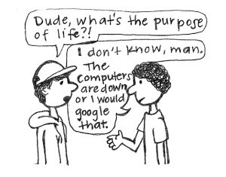

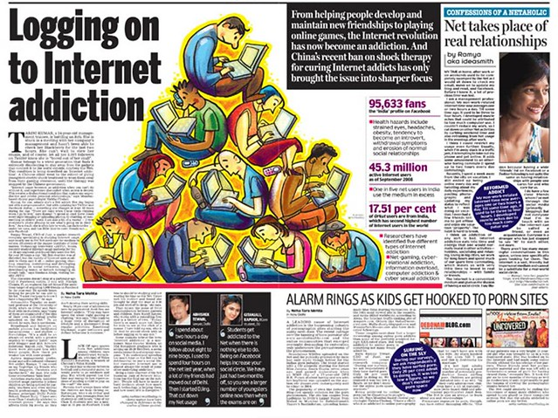
The Disadvantages
However, for all its advantages and positive aspects, the internet has its dark and ugly side too. With a large amount of information freely available on the internet theft and misuse of this information is a likely possibility.Children nowadays seem losing their ability to communicate with others. They are used to communicate with others via internet but they cannot communicate with others face by face fluent. It was a strange sight that internet had make people losing their ability to communicate. It is because people now are over depending on internet.

Slide 7



Another problem or disadvantage of the internet is that it has allowed a great deal of anonymity to a large number of people who may access the different websites, forums and chat rooms available. This has allowed perverted individuals to at times take advantage of innocent people and abuse their trust. We can always hear from news that cheaters used internet to make crimes. The cheaters will make friends with single ladies and cheat them by using sweet words. Lonely single ladies are very easy get in trap of these cheaters.Another disadvantage of internet is harmful to little children. Children nowadays are explored to internet and they are used to maintain internet as their daily life. This is one of the greatest threats internet poses to children. Internet has provided an easy medium to children to gain access to pornography and this can cause them to either become sexually-deviant or sexually-addictive.If you have been following news lately then you must know what we are referring to. Children have been lured by paedophiles posing as good Samaritans and have been physically abused and molested. Internet has also made it easy for unscrupulous elements to get in touch with children and this has led to an increase in the cases of kidnapping and identity thefts.

Slide 8
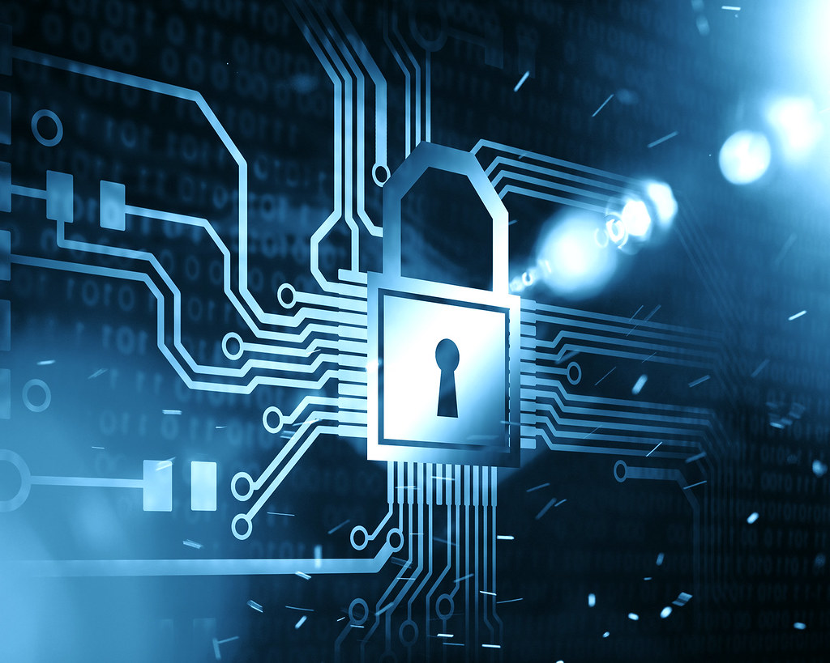

Conclusion
The points mentioned above have posed new challenges to teachers and parents.However, we believe that instead of making internet a taboo, we should educate children to use it for their benefit. It is advisable for parents to monitor how much time their children spend on the internet, and if possible set a time-limit till which they would be allowed to use the internet.Lastly, we have to take the responsibilities to guide out children to use internet wisely and ensure them to get right information from internet.
Cím: Fénykép, készítette: Ismeretlen szerző, licenc: CC

Slide 9



Slide 10
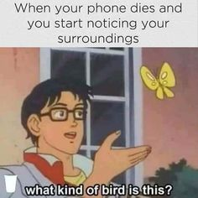


Slide 11


